Slide 1

Implementing Utilitarianism – Expected Value

Slide 2
Implementing Utilitarianism
ACT:
RULE:
Notes:
Repeated from previous powerpoint to review the problem. How to compute utility when we are not sure of the outcome.

Slide 3
Expected Value
Choice
action₁
action₂
action_{n}
prob₁
prob₂
prob₃
prob_{k}
1
2
3
k
payoff₁
payoff₂
payoff₃
payoff_{k}
expectation₁
= payoff₁·prob₁
expectation₂
expectation₃
expectation_{k}
= payoff_{k}·prob_{k}
Expected Value(action_{i}) =

Slide 4
Implementing Utilitarianism
ACT:

Slide 5
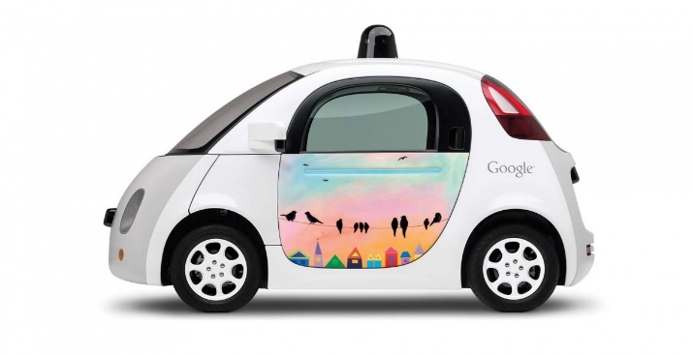
Implementing Utilitarianism
ACT:
Notes:
If we are going to build systems like self-driving cars, we are going to need to make them behave ethically. To do that we must be clear what that means.
http://www.forbes.com/sites/brookecrothers/2015/11/12/google-is-leader-in-revolutionary-self-driving-cars-says-ihs/#1fc314e3e6b1

